Slide 1

Predictive Modeling of Customer Bookings
This presentation covers the process of building a predictive model for customer booking completion using a real dataset. We explore the data, perform feature engineering, encode categorical variables, and train a machine learning model to predict booking outcomes. The goal is to understand key factors influencing bookings and evaluate model performance.

Slide 2
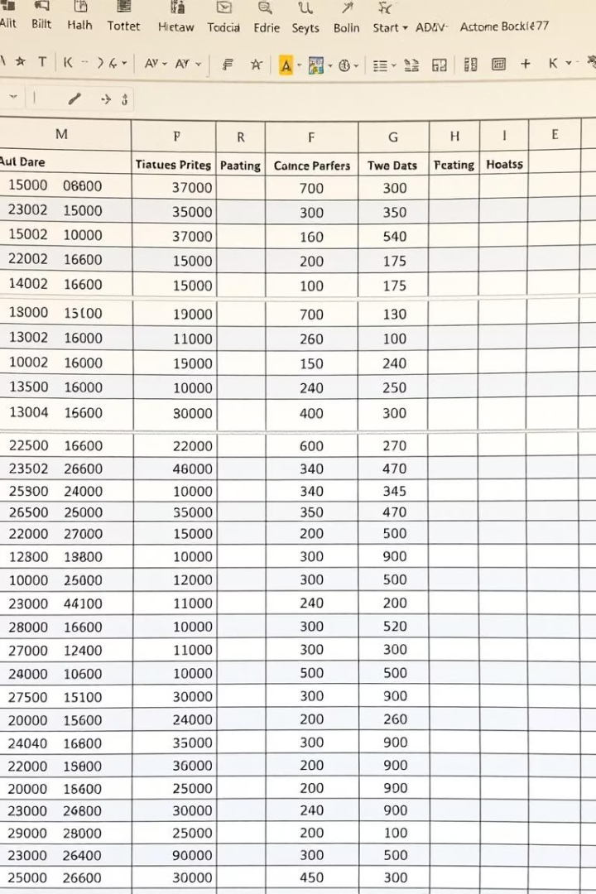
Exploratory Data Analysis
Dataset Overview
Data Types & Completeness
The dataset contains 50,000 entries with 14 columns including passenger count, sales channel, trip type, purchase lead time, and booking completion status.
All columns have non-null values. Some categorical columns like flight day require conversion for analysis.
Initial Inspection
Using methods like .head() and .info(), we get a snapshot of data structure and types to guide preprocessing steps.

Slide 3

Data Preparation and Conversion
Flight Day Mapping
Sales Channel Encoding
Trip Type Encoding
Converted flight day names to numeric values for modeling (e.g., Mon=1, Tue=2, ...).
Mapped sales channel to binary values: Internet=0, Other=1, simplifying feature usage.
Mapped trip types to integers: RoundTrip=1, CircleTrip=2, OneWay=3, enabling numerical analysis.

Slide 4
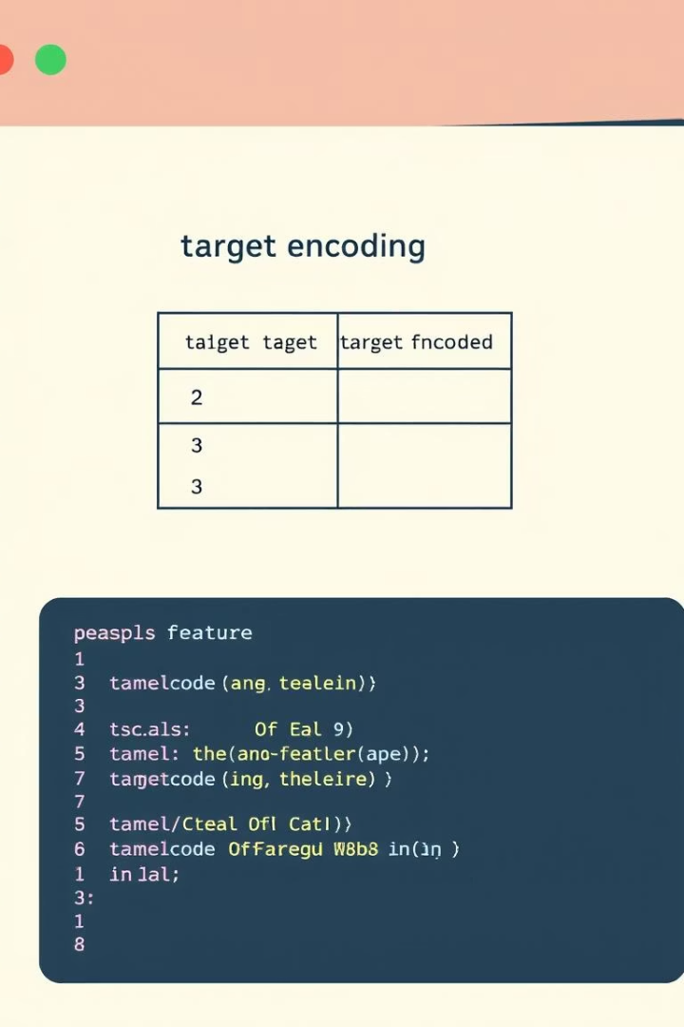



Feature Engineering with Target Encoding
Identify Categorical Features
Selected 'route' and 'booking_origin' for encoding due to their categorical nature.
Apply K-Fold Target Encoding
Used 5-fold cross-validation to compute mean booking completion rates per category, reducing overfitting risk.
Replace Original Columns
Dropped original categorical columns after encoding to prepare data for modeling.

Slide 5
Model Training and Evaluation
Model Selection
Performance Metrics
Trained a Random Forest Classifier with 100 trees on 80% of the data to predict booking completion.
Achieved 86% accuracy on the test set, indicating strong predictive capability. R2 score was negative, reflecting classification context.

Slide 6
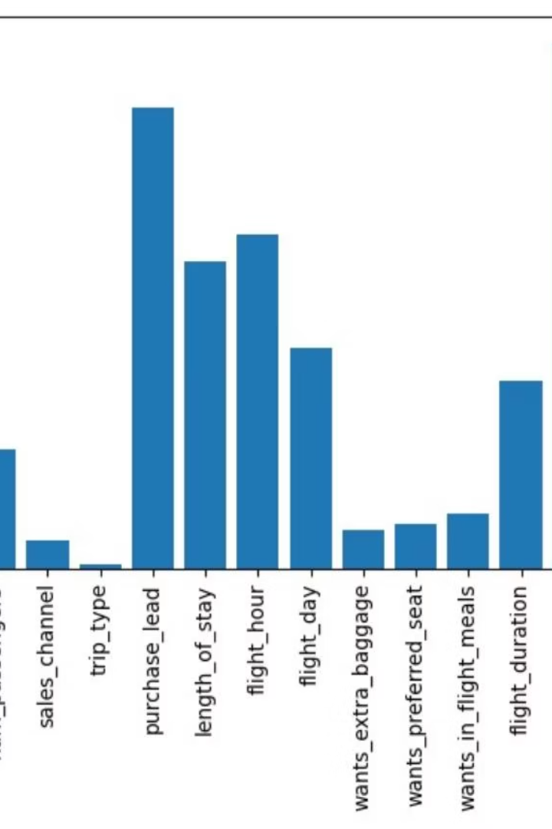
Feature Importance Analysis
The model highlights key features influencing booking completion, such as purchase lead time, length of stay, and encoded route and booking origin. Understanding these helps prioritize factors in marketing and customer targeting strategies.

Slide 7
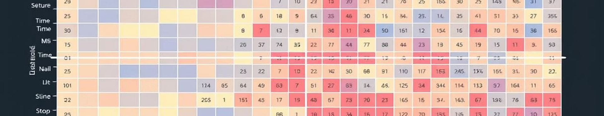
Correlation Insights
Correlation between features shows moderate relationships, with booking completion positively correlated with booking origin and route encoding.
Correlation analysis reveals subtle interactions between variables, guiding feature selection and model refinement to improve predictive accuracy.

Slide 8

Summary and Next Steps
Data Exploration
Thoroughly examined dataset structure and statistics to understand variables.
Feature Engineering
Encoded categorical variables and prepared data for modeling.
Modeling & Evaluation
Trained Random Forest model with 86% accuracy and analyzed feature importance.
Future Work
Explore additional models, fine-tune parameters, and incorporate more features for improved predictions.

